Slide 1
MeshEdit Lab
Manipulate Shape!

Slide 2
“I hate meshes. I cannot believe how hard this is. Geometry is hard.”
— David Baraff, Senior Research Scientist, Pixar Animation Studios

Slide 3
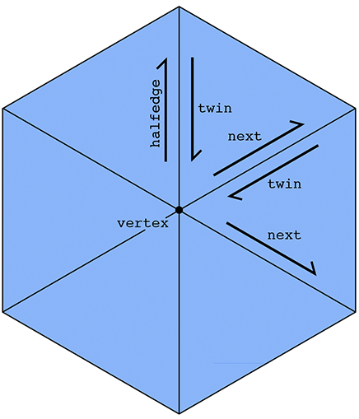
Conceptual: Halfedge Meshes
Vertex {
Halfedge outgoing;
}
Edge {
Halfedge one_side;
}
Face {
Halfedge from_inner_loop;
}
Halfedge {
Vertex start_point;
Edge goes_along;
Face lives_in;
Halfedge twin;
Halfedge next;
}
class Halfedge_Mesh { class Vertex{}; class Edge{}; class Face{}; class Halfedge{}; }

Slide 4
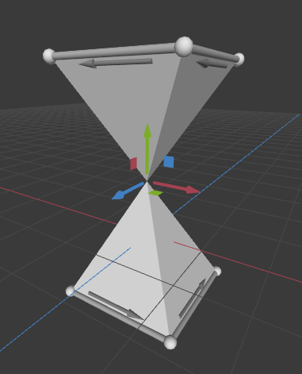
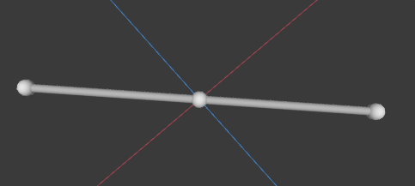
Conceptual: Manifold Geometry
Each edge is contained in exactly two faces + the neighborhood of every vertex is flat.
A halfedge mesh can only represent manifold geometry, so a valid mesh is always manifold.
However, when rendered with linear mesh elements (triangles), a valid mesh may appear to be non-manifold.
Your friend: std::string Halfedge_Mesh::validate();

Slide 5
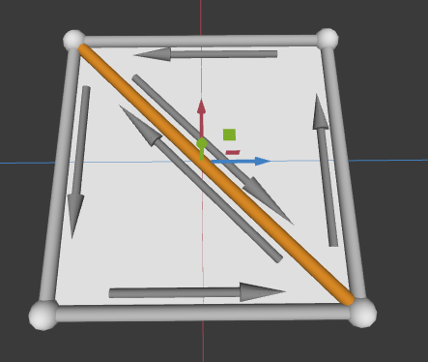
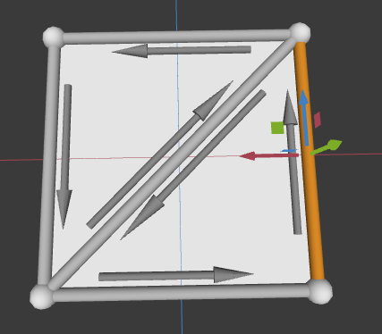
Conceptual: Edge Cases
Your operations must maintain the validity of the mesh
If it is not possible to perform the operation and remain valid, you should not perform it
Your operations should never crash
Your operations should be user-friendly
If the result of the operation would be difficult to work with for the user, you should also not perform it (or change your strategy)
Collapse?
Flip?

Slide 6
Part 1: Local Operations

Slide 7
Local Operations:
Required:
Flip Edge
Split Edge
Collapse Edge
Bevel Face
Implement 1 (required) or more (extra credit) of the following local ops:
Bevel Vertex
Bevel Edge
Erase Vertex
Erase Edge
Collapse Face
*see meshedit.cpp for some very helpful comments ;^)

Slide 8
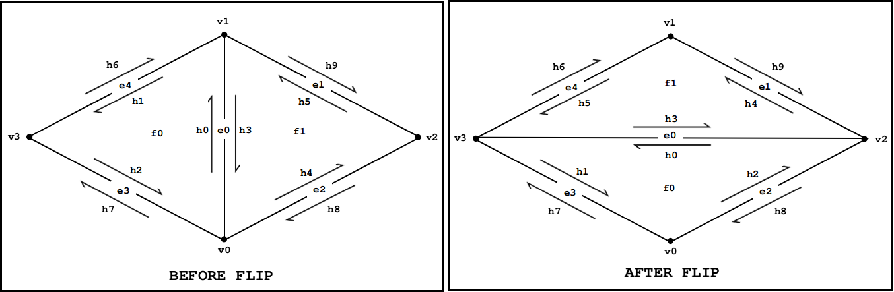
Local Operations: Flip Edge
v1
h6
h9
e4
f0
e1
h1
h5
h0
v3
e0
v2
h2
h3
h4
e3
f1
e2
h7
h8
v0
std::optional<EdgeRef> Halfedge_Mesh::flip_edge(EdgeRef edge);

Slide 9
PSA:
The diagrams on the documentation doesn’t faithfully represent all the cases! Think about different meshes and draw out some diagrams when you are implementing meshedit.

Slide 10

Local Operations: Flip Edge
v1
h6
h9
e4
f0
e1
h1
h5
h0
v3
e0
v2
h2
h3
h4
e3
f1
e2
h7
h8
v0

Slide 11
Local Operations: Collapse Edge

Slide 12
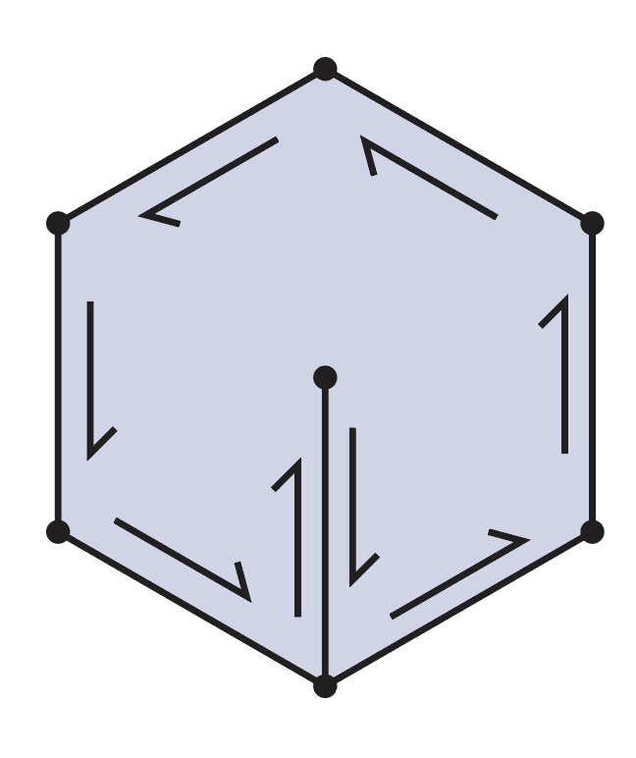
Local Operations: Erase Edge
An unfriendly but legal geometry

Slide 13
Local Operations: Crazy Geometry
that you should try to “fail gracefully”
So not like this! You probably don’t want to bevel a face like this one

Slide 14
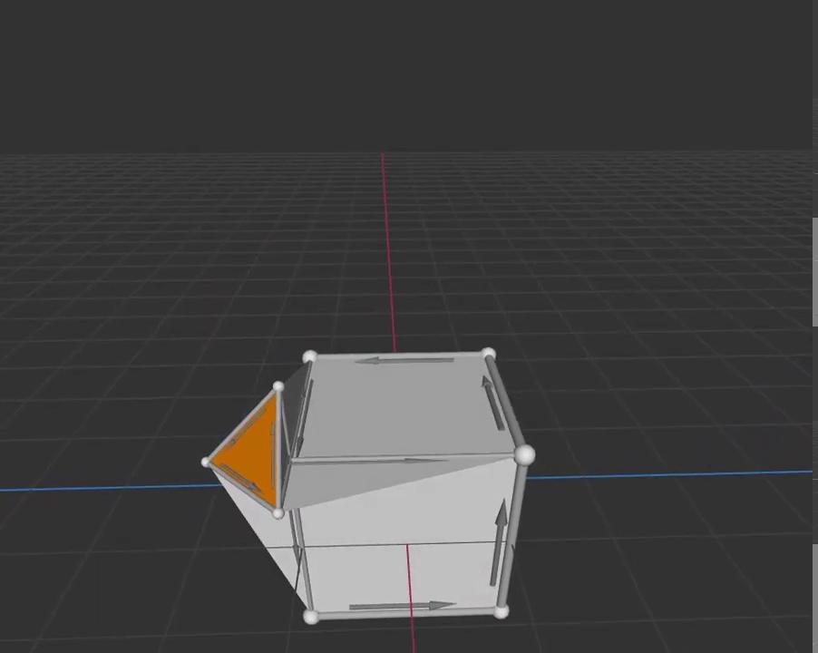
Local Operations: Beveling

Slide 15
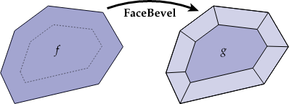
Local Operations: Bevel Face
std::optional<FaceRef> Halfedge_Mesh::bevel_face(FaceRef edge);
void Halfedge_Mesh::bevel_face_positions(const std::vector<Vec3>& start_positions,
FaceRef face, float tangent, float normal);
bevel_face_positions: normal and tangent offset gives you an absolute offset relative to the start positions, not a delta

Slide 16
Helpful functions:
Edge::center()
Edge::normal()
Face::center()
Face::normal()
…...and more, see src/geometry/halfedge.h

Slide 17
Part 2: Global Operations

Slide 18
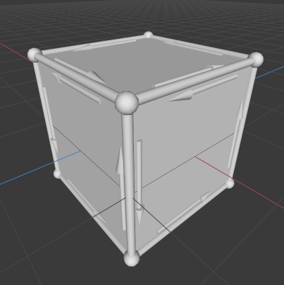
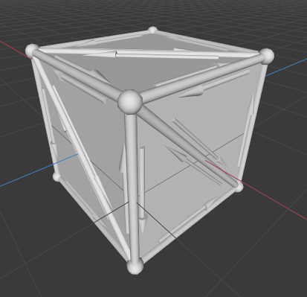
Global Operations: Triangulation
void Halfedge_Mesh::triangulate();

Slide 19
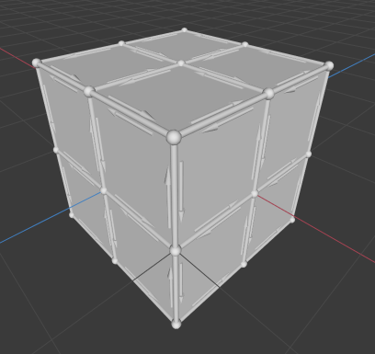
Global Operations: Linear Subdivision
void Halfedge_Mesh::linear_subdivide_positions();

Slide 20
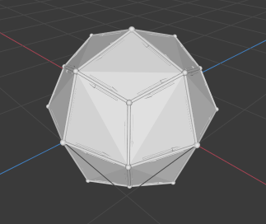
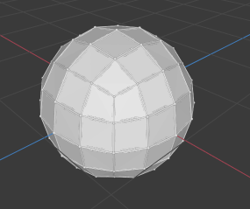
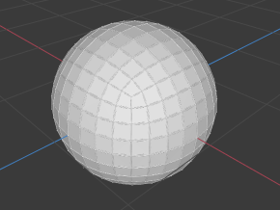
Global Operations: Catmull-Clark Subdivision
You implement: computing position for each new vertex. Each new vertex comes from a old vertex, face, or edge.
Provided: Using your positions to construct the subdivided mesh.
void Halfedge_Mesh::catmullclark_subdivide_positions();

Slide 21
Optional Global Operations
Implement 1 (required) or more (extra credit) of the following global ops:
Loop Subdivision
Isotropic Remeshing
Mesh Simplification
These three are for triangle meshes only.

Slide 22
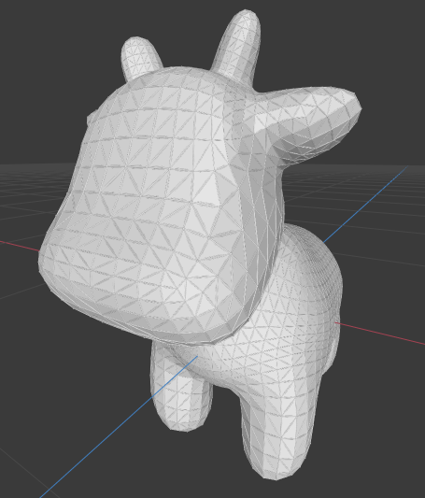
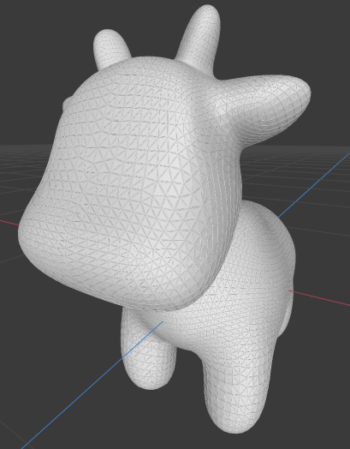
Global Operations: Loop Subdivision
void Halfedge_Mesh::loop_subdivide();

Slide 23
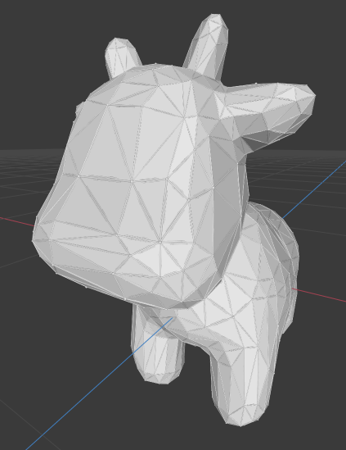
Global Operations: Simplification
void Halfedge_Mesh::simplify();

Slide 24
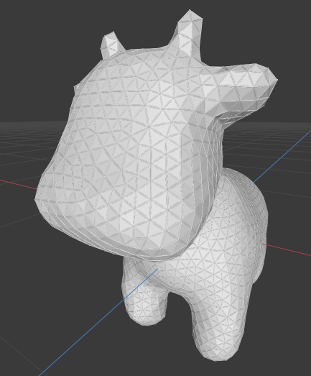
Global Operations: Isotropic Remeshing
void Halfedge_Mesh::isotropic_remesh();

Slide 25
Meshes in Scotty3D
Scotty3D C++ Reference: https://cardadfar.github.io/Scotty3D-Cpp-Help/

Slide 26
Codebase: Halfedge_Mesh
Main class for MeshEdit
Elements are stored in doubly linked std::list<>s
Stores boundary faces separately
Verts
v
v
Edges
e
e
Faces
f
f
Halfedges
h
h
h
h

Slide 27
Codebase: Mesh Elements as Iterators
std::list<> iterators are like pointers to nodes
We refer to a mesh element by its iterator, which we rename as Ref
Each vertex, edge, and face contains a HalfedgeRef, and each halfedge contains a VertexRef, EdgeRef, FaceRef, and twin/next HalfedgeRefs
Lots of inter-list relationships! Be careful when deleting elements.
Verts
v
v
Edges
e
e
Faces
f
f
Halfedges
h
h
h
h

Slide 28
Example: Computing vertex degree
unsigned int Halfedge_Mesh::degree(Halfedge_Mesh::VertexRef v) {
Unsigned int d = 0;
HalfedgeRef h = v->halfedge();
do {
d++;
h = h->twin()->next();
} while (h != halfedge);
return d;
}
Some considerations
Are edge degree and face degree the same?
What about boundary faces?

Slide 29
Codebase: Edge Cases & Testing
std::optional<Halfedge_Mesh::VertexRef> Halfedge_Mesh::collapse_edge(Halfedge_Mesh::EdgeRef e) {
if (it doesn’t make sense to collapse e)
return std::nullopt;
VertexRef new_vertex = /* collapse edge */;
return new_vertex;
}
optional<T>: either a value of type T or std::nullopt
Halfedge_Mesh::validate() is called after every operation
Will detect if you produce invalid connectivity or bad vertex positions.
Will not detect correct connectivity.
May crash if you have dangling references.

